Slide 1
Architecture Design
Dr. Yan Yan

Slide 2
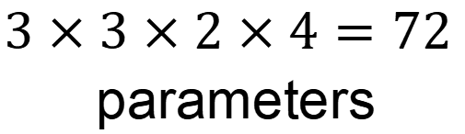
Review: Standard CNN
$$3×3×2×4=72$$
parameters
Input feature map
2 channels

Slide 3
Depthwise Separable Convolution
Depthwise Convolution
Filter number = Input channel number
Each filter only considers one channel.
The filters are $k×k$ matrices
There is no interaction between channels.

Slide 4

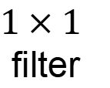

Depthwise Separable Convolution
Depthwise Convolution
$$3×3×2=18$$
Pointwise Convolution
$1×1$
filter
$$2×4=8$$

Slide 5











Depthwise Separable Convolution
$$k×k×I$$
$I$: number of input channels
$$k×k×I$$
$$k×k×I$$
$O$: number of output channels
$k×k$: kernel size
$$k×k×I$$
$$k×k×I+I×O$$
$$k×k×I×O$$
$$I×O$$
$$k×k×I$$
$$=\frac{1}{O}+\frac{1}{k×k}$$
$$k×k×I+I×O$$
$$(k×k×I)×O$$

Slide 6
Low rank approximation
M
M
U
W
linear
K
V
N
N
N
K
N
W
U
V
K
M
≈
M
K < M,N
Less parameters

Slide 7
18 inputs
18 inputs
9 inputs
9 inputs

